Slide 1

Mental Health
in the
Work Environment
Medical Treatment Dataset
John Mintsa, Nathan Magno, Kiet Nguyen, Kierra Manuel

Slide 2
Agenda
Introduction
Decision Tree & Random Forest
Logistic Regression & Ensemble Method
Neural Network
Boosted Trees and Support Vector for Machines
Conclusion

Slide 3
Background
As workplace burnout, fatigue levels rise, and individuals increasingly leave their jobs due to toxic workplace cultures for the sake of their mental health, addressing mental health issues in the workplace has become a critical concern.
In response to this growing challenge, our project focuses on evaluating and identifying the most effective model for classifying whether participants require mental health treatment.
We aim to achieve this by leveraging a comprehensive Medical Treatment Dataset.

Slide 4
Our Dataset
Dataset Overview:
28 Categorical Attributes and 1 Numerical Attribute (Age)
Balanced Dataset (48.3% Need Treatment and 51.7% DO NOT Need Treatment)
Comprehensive information related to mental health
Includes variables such as self-employment, family history of mental illness, and perceptions of employer support
Target Variable:
Prediction target is “Treatment” variable
Objective:
Facilitates the evaluation of different models for accurate classification of individuals who may require health treatment.

Slide 5
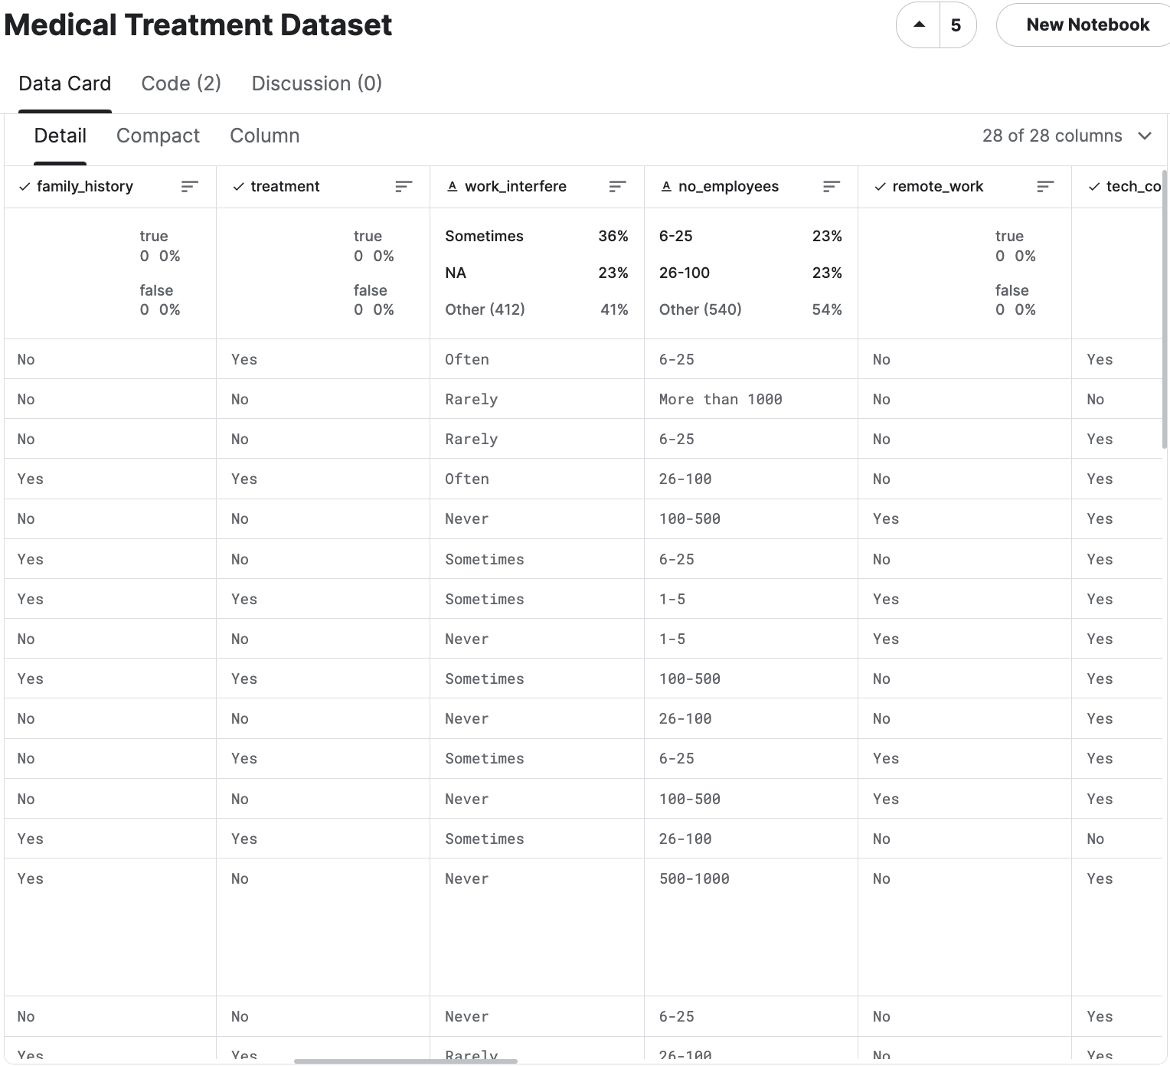
Our Dataset

Slide 6
Decision Tree & Random Forest

Slide 7
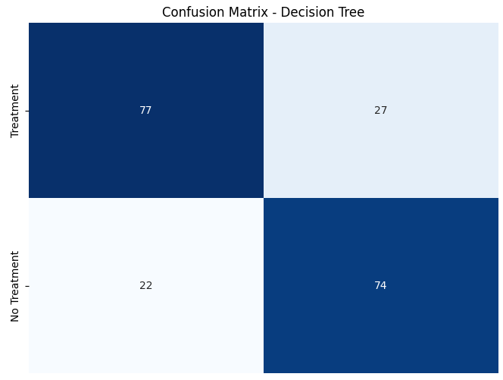
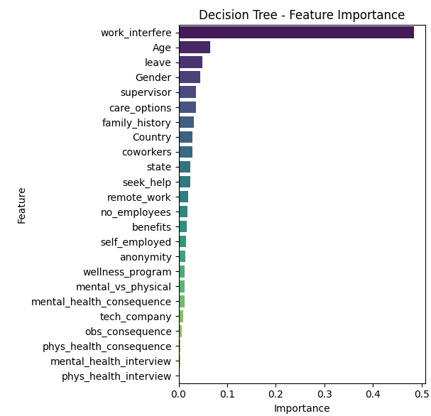
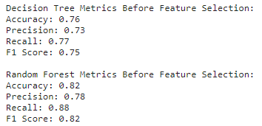
Decision Tree

Slide 8
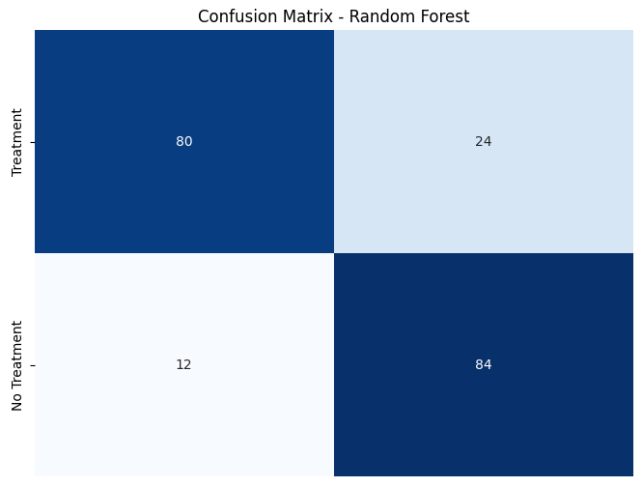
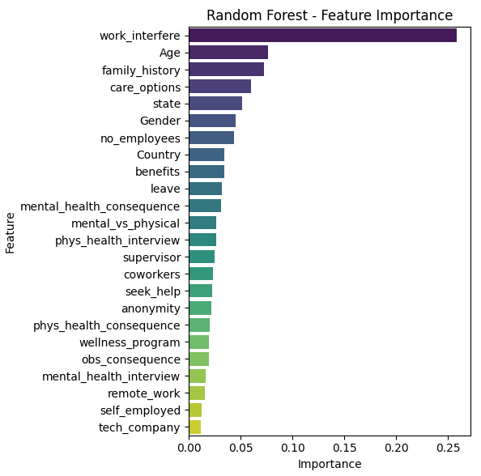
Random Forest

Slide 9
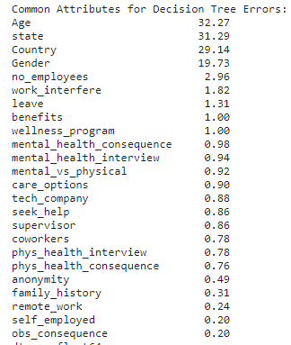
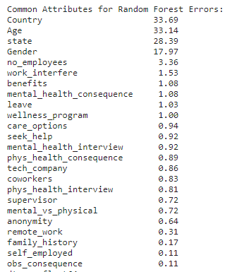
Common Attributes Error For Decision Tree & RF

Slide 10
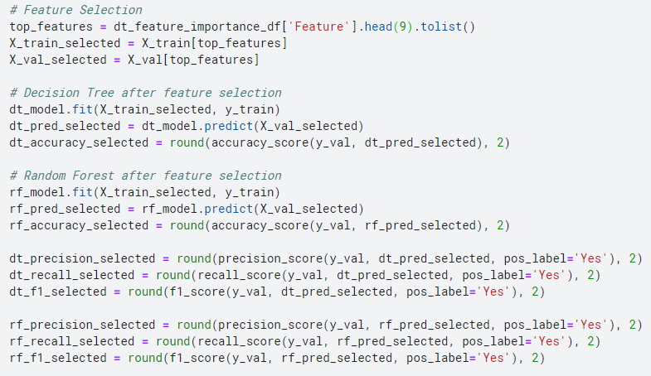
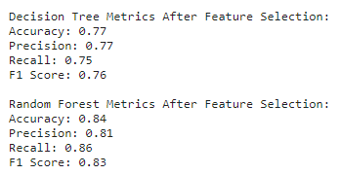
Decision Tree & RF Accuracy Improvement

Slide 11
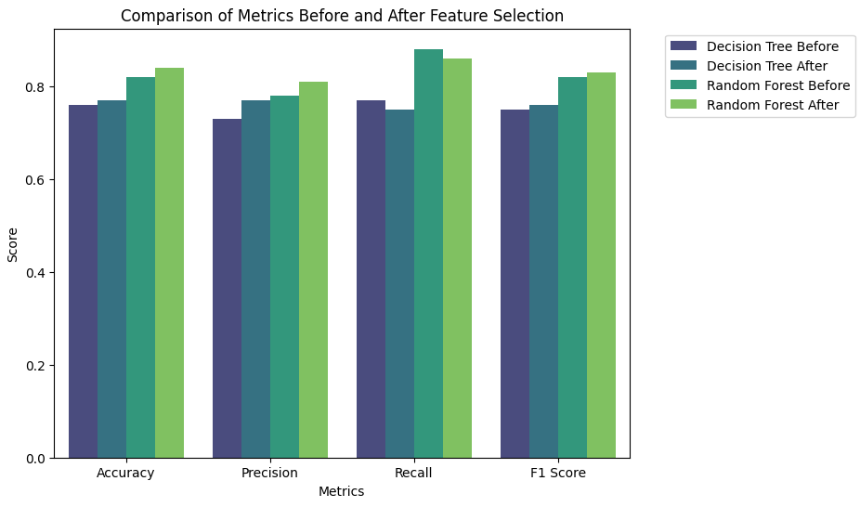
Decision Tree & RF Accuracy Improvement Result
Feature selection led to improvements in accuracy and precision for both models.
Decision Tree showed a small decrease in recall after feature selection, suggesting a potential trade-off between precision and recall.
Random Forest sees improvements in accuracy, precision, and F1 score after feature selection, with a slight decrease in recall.

Slide 12
Logistic Regression &
Ensemble Method

Slide 13
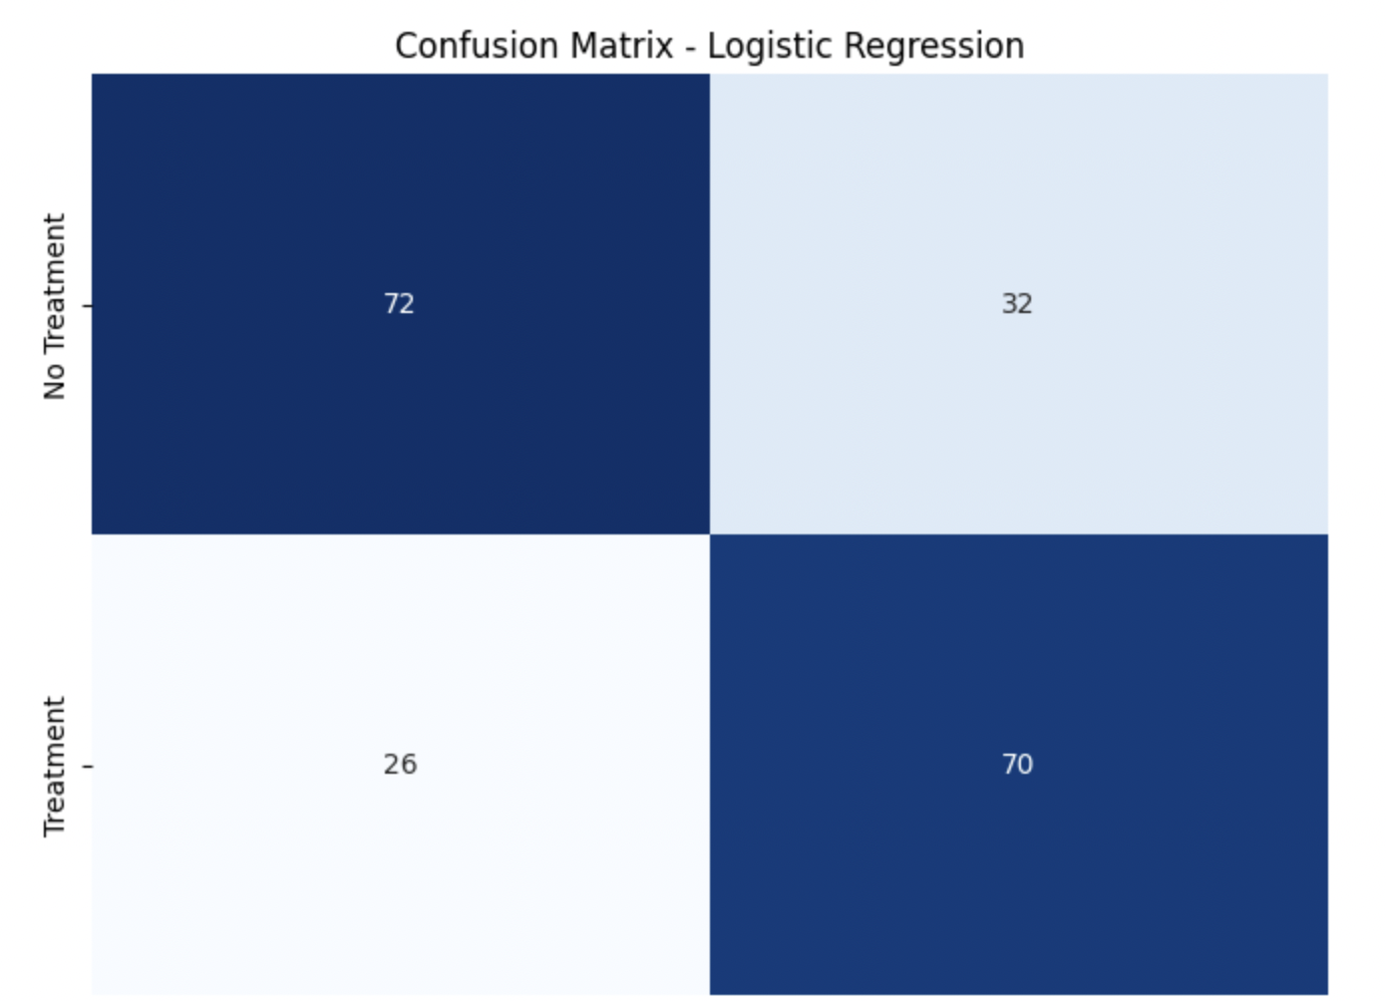
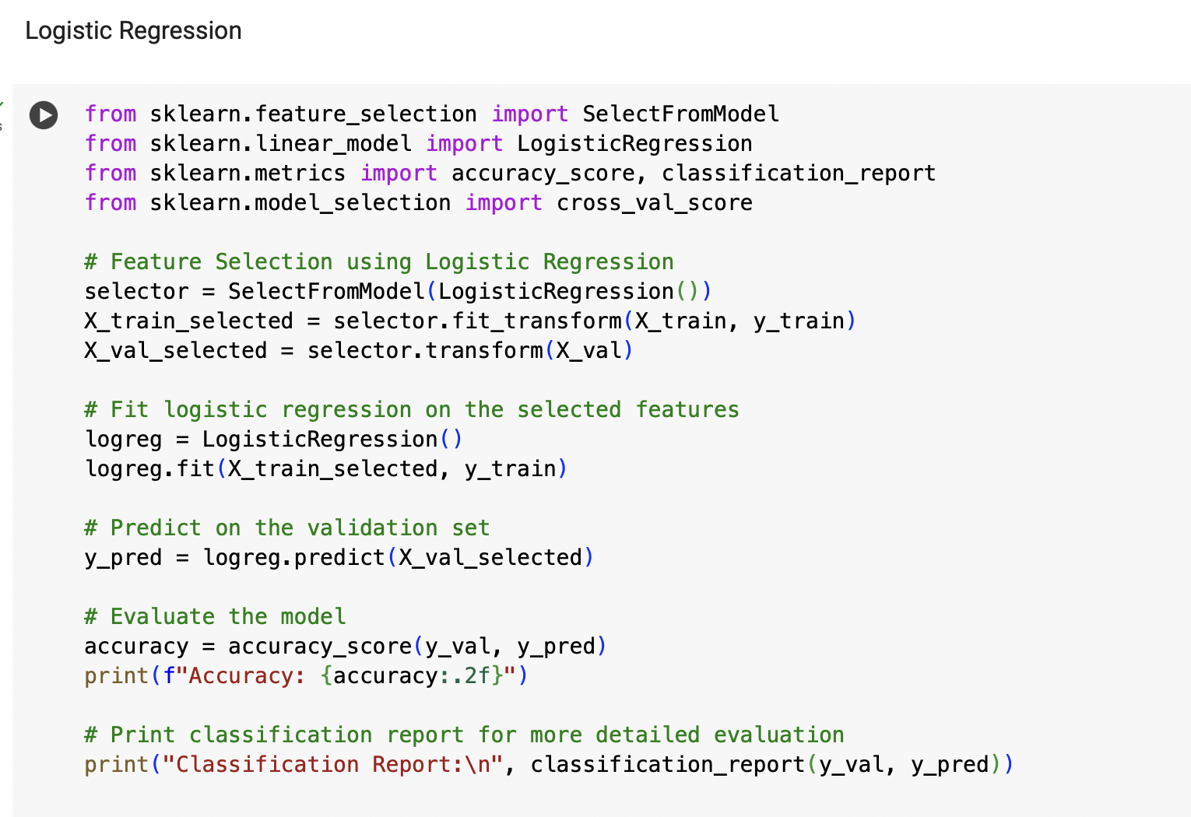
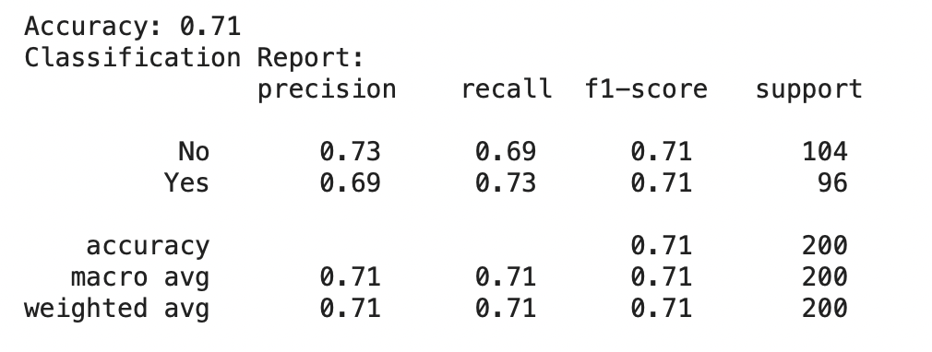
Logistic Regression

Slide 14
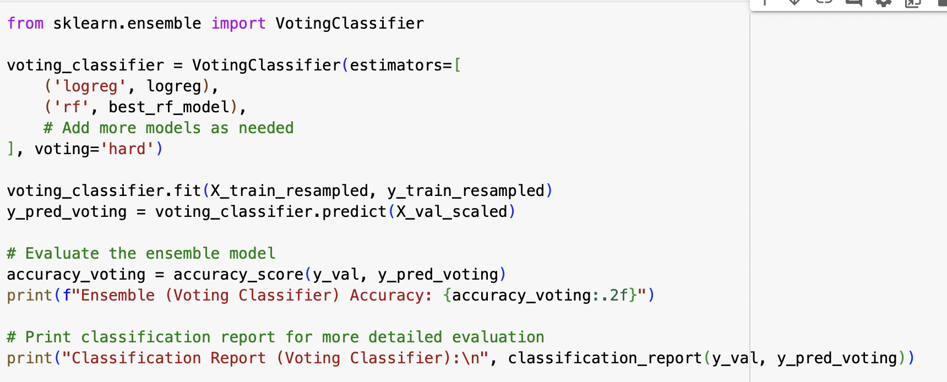
Logistic Regression Accuracy Improvements
Ensemble method (Voting Classifier)
Logistic Regression and Random Forest Models
Overall accuracy improved from 71% to 79%
Ensemble method uses the strengths of the individual models for a more comprehensive and accurate prediction mechanism
The results demonstrate effectiveness of mitigating limitations of standalone models

Slide 15
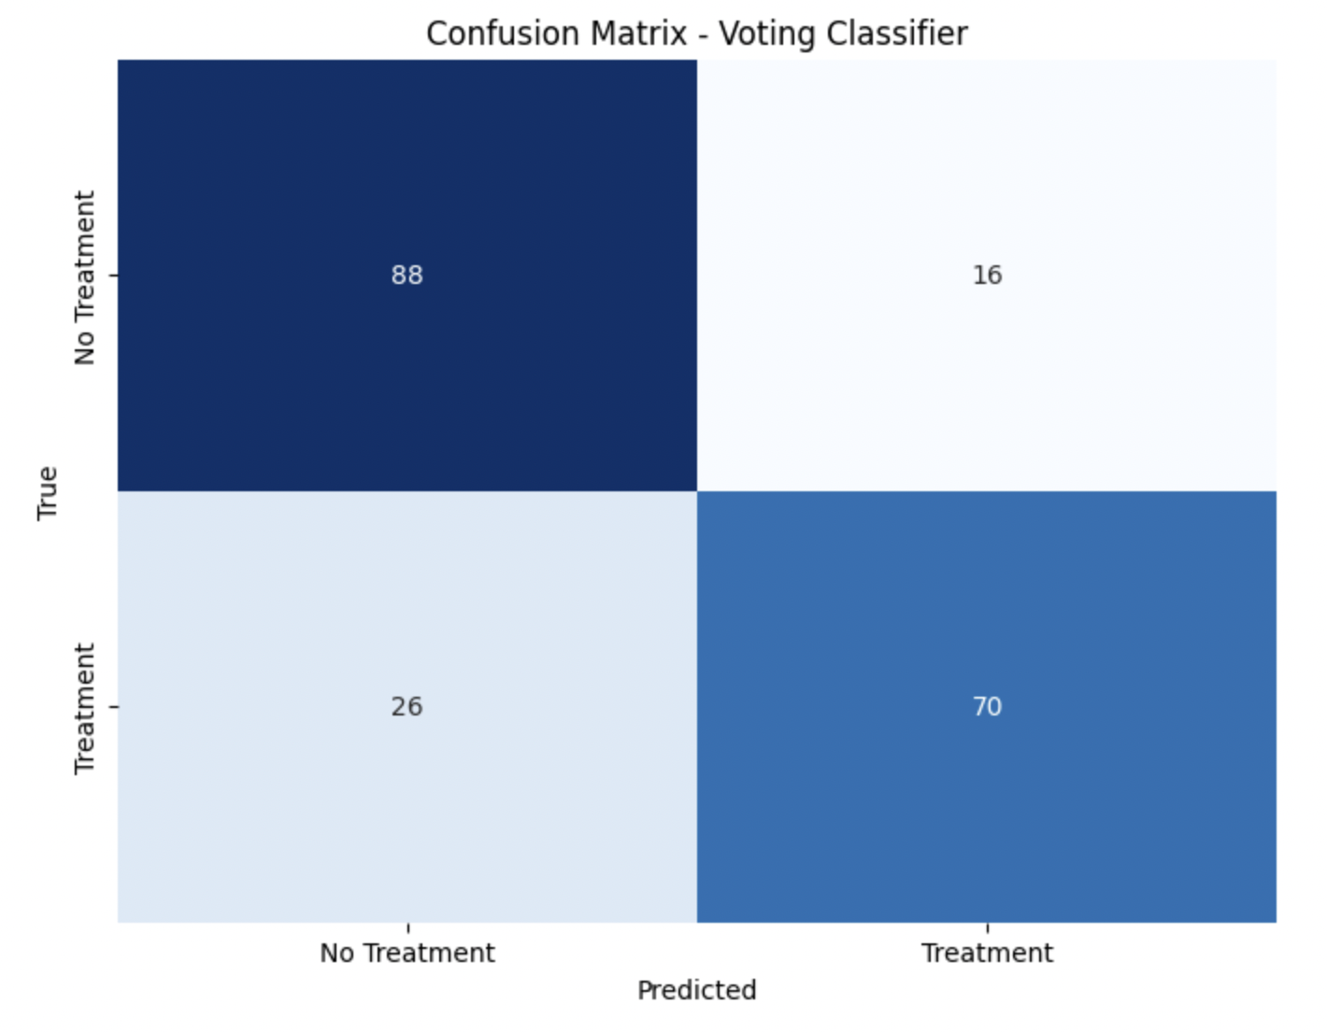
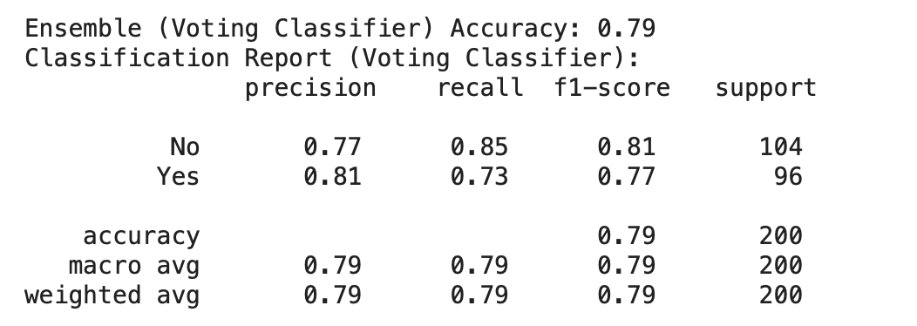
Accuracy Improvement Results

Slide 16
Neural Network

Slide 17
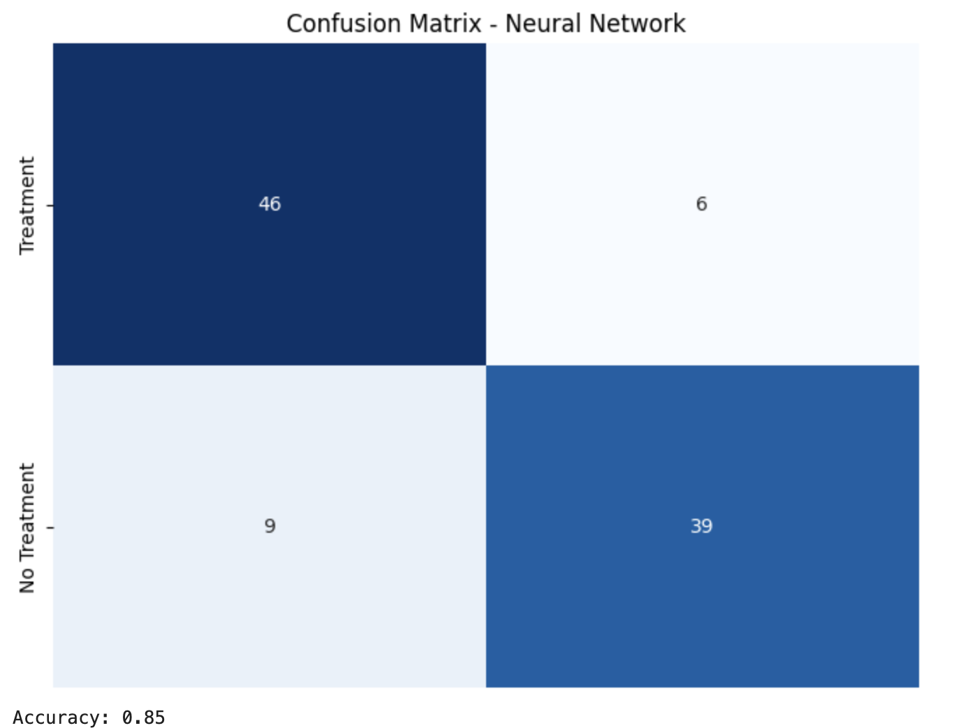
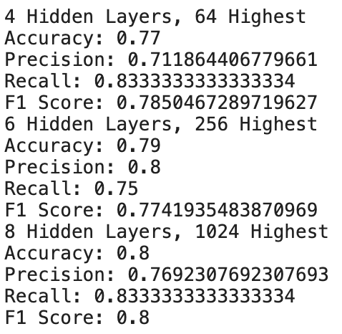
Neural Network

Slide 18
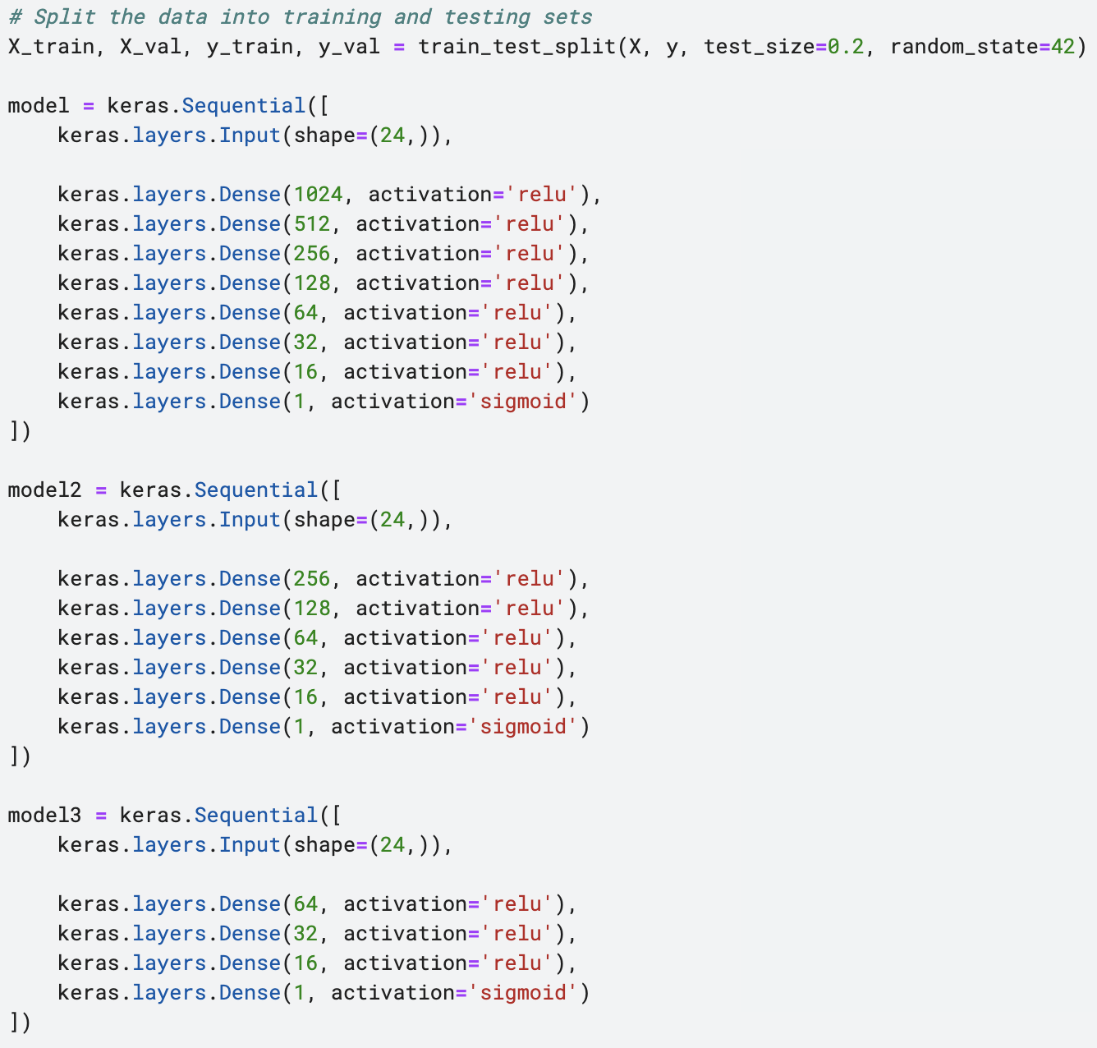
Hidden Layer Analysis

Slide 20
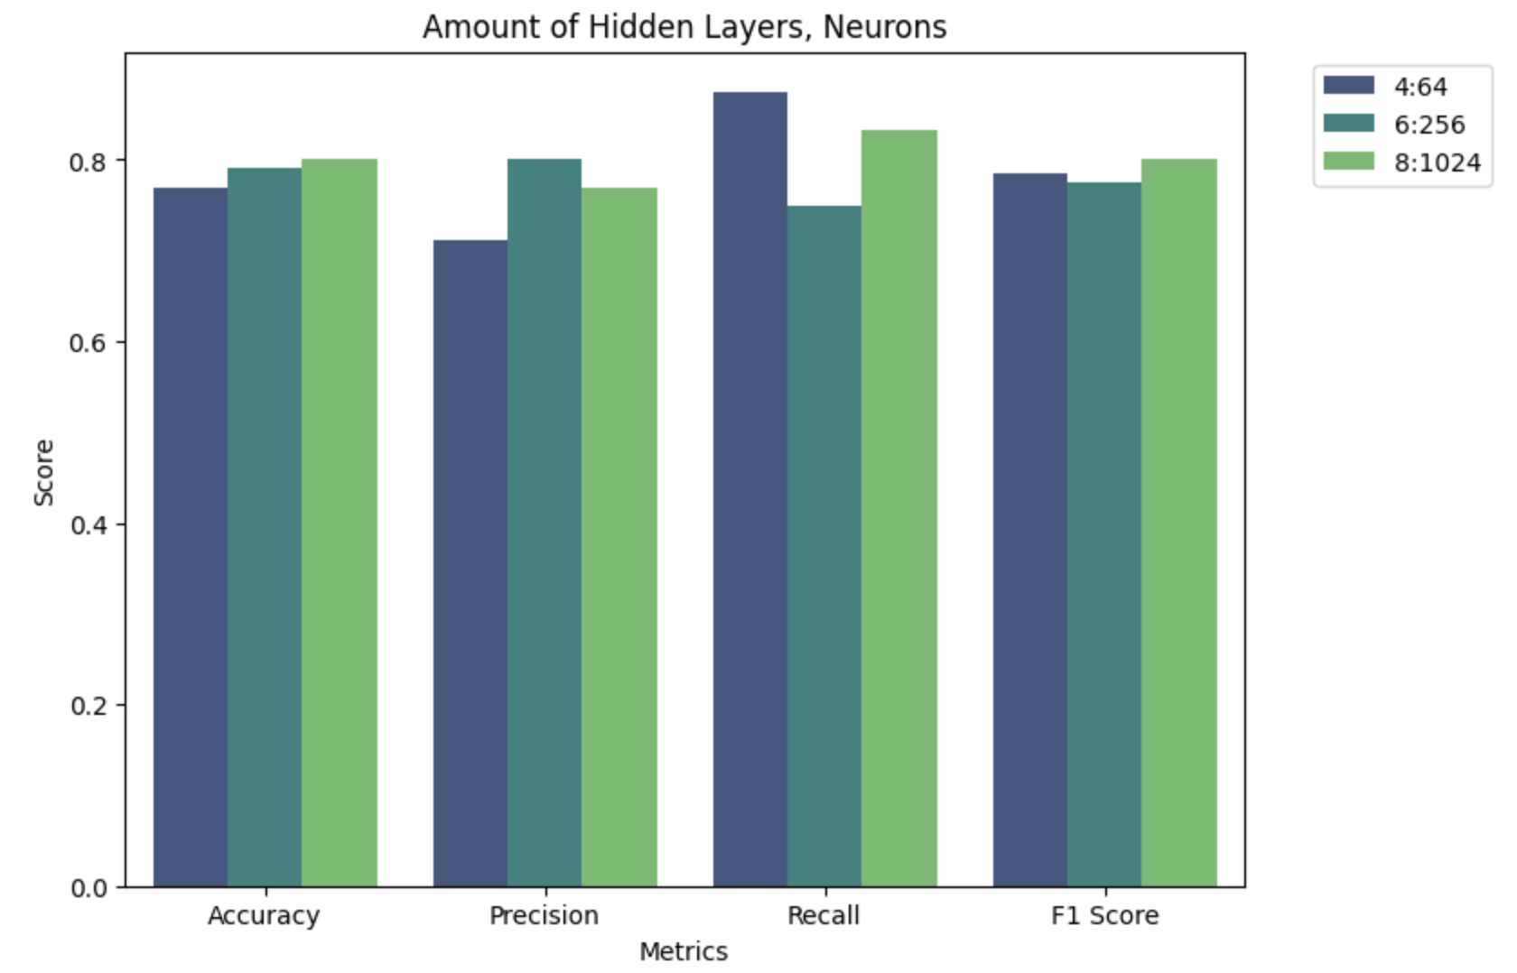
Hidden Layer Analysis

Slide 21
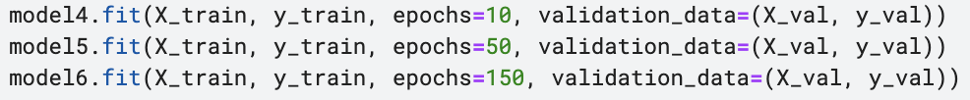
Epoch Analysis

Slide 22
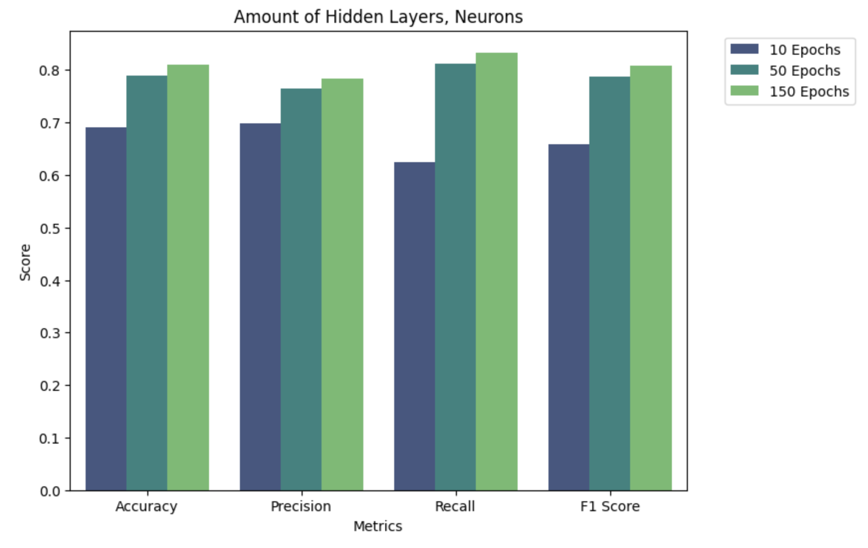
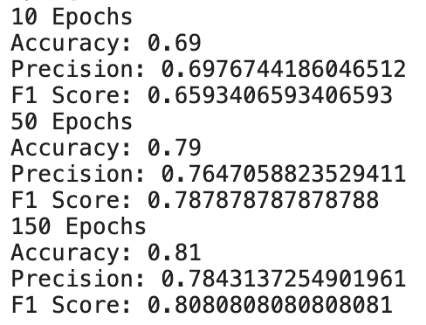
Epoch Analysis

Slide 23
Altering Train/Test Split

Slide 24
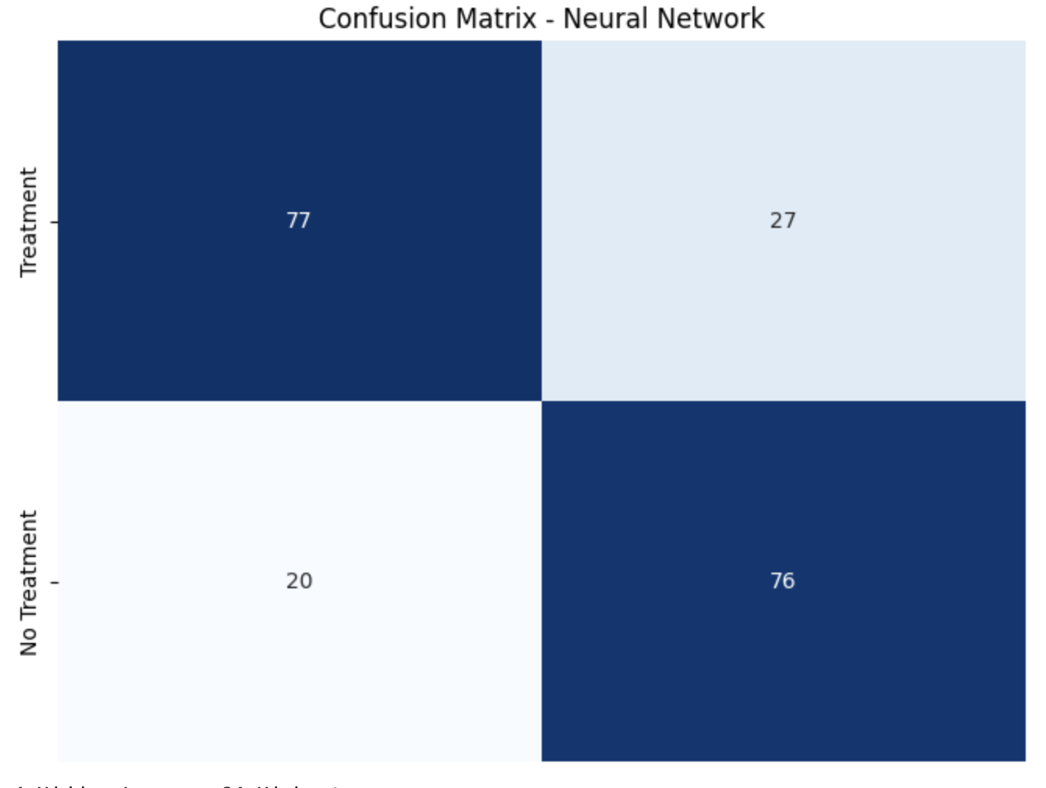
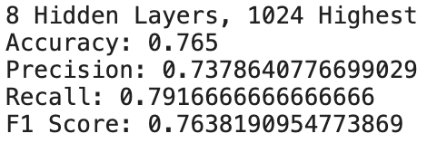
Altering Train/Test Split

Slide 25
Gradient Boosting and Support Vector for machines

Slide 26
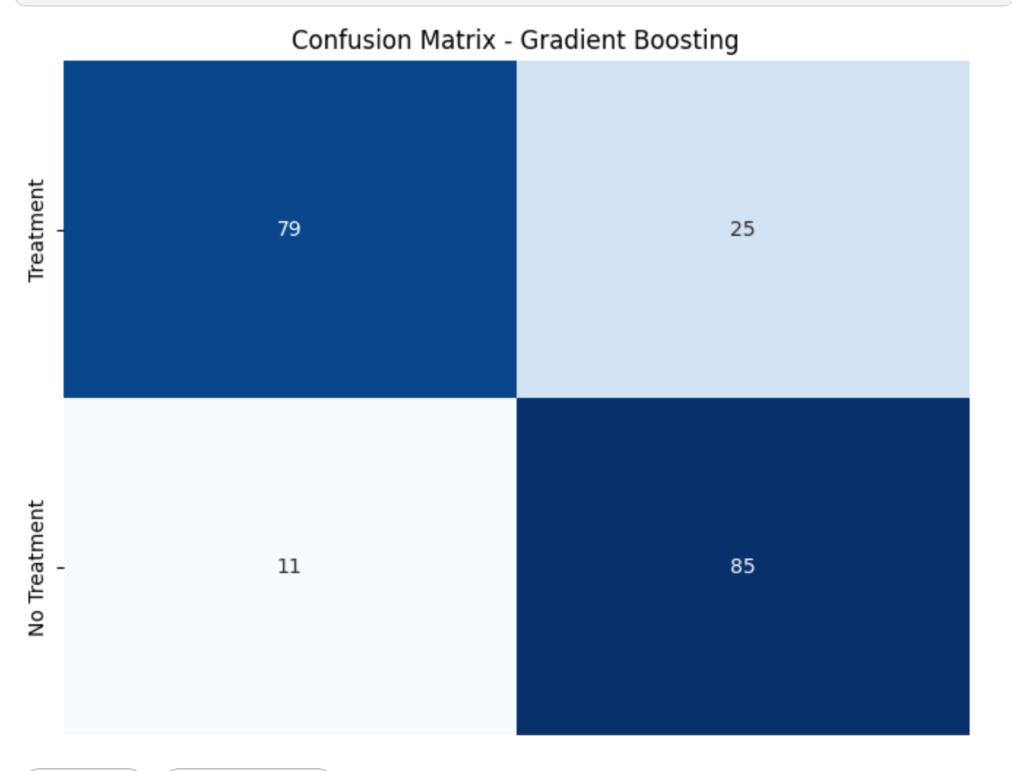
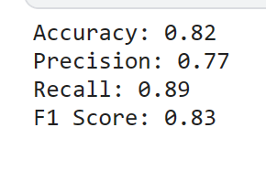
Gradient Boosting

Slide 27
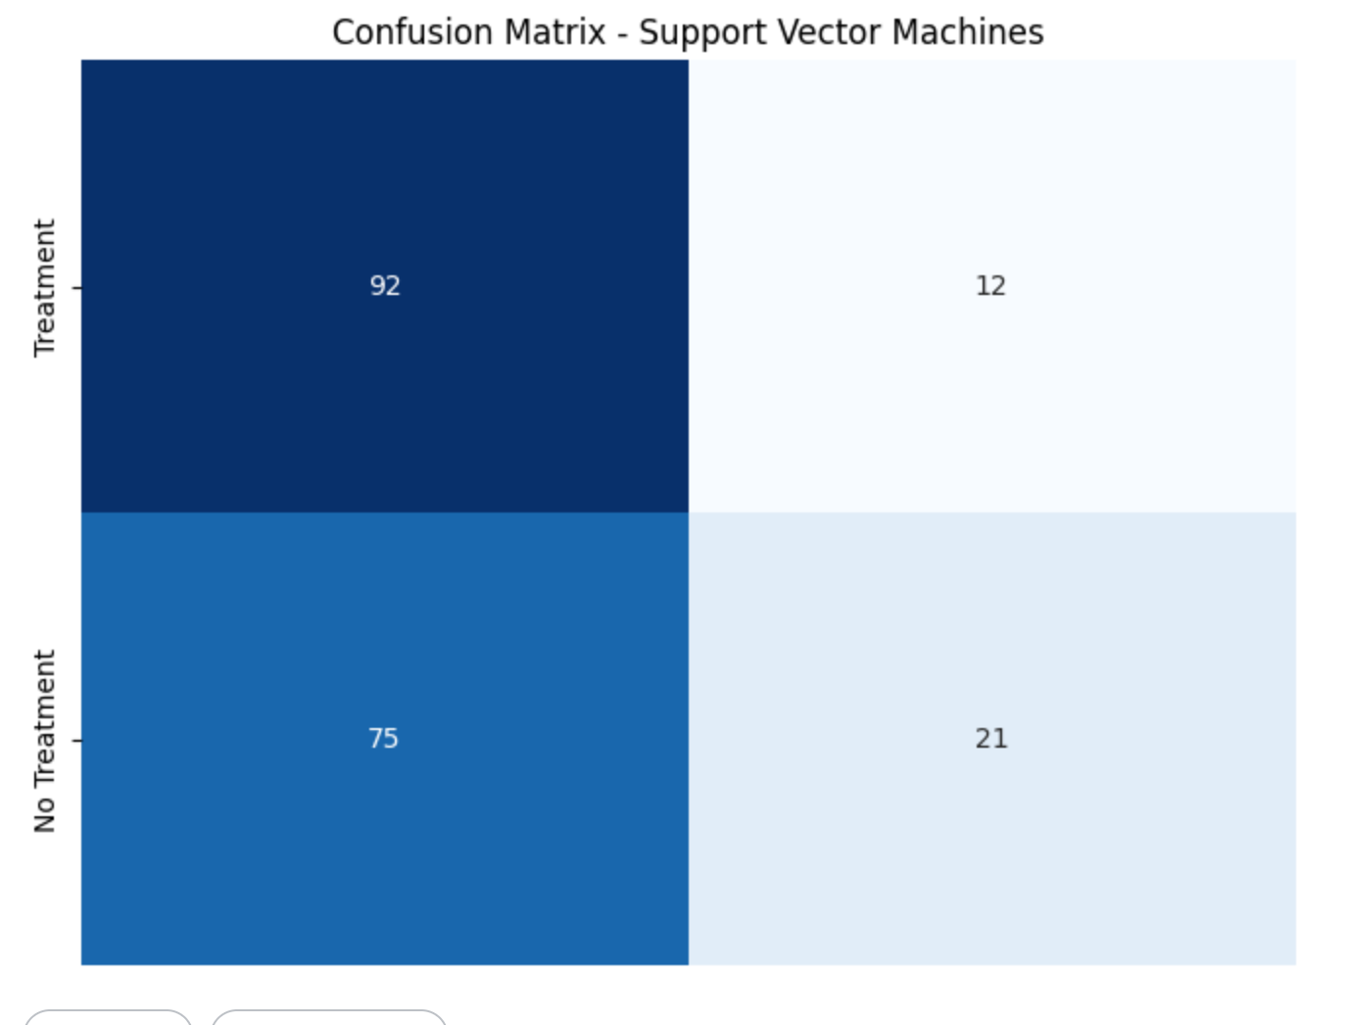

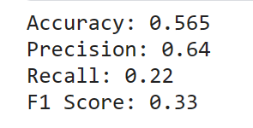
Support Vector for machines
Support Vector Machines (SVM) is a supervised machine learning algorithm that can be used for both classification and regression tasks. SVM is particularly effective in high-dimensional spaces and is well-suited for cases where the decision boundary between classes is complex or nonlinear.

Slide 29
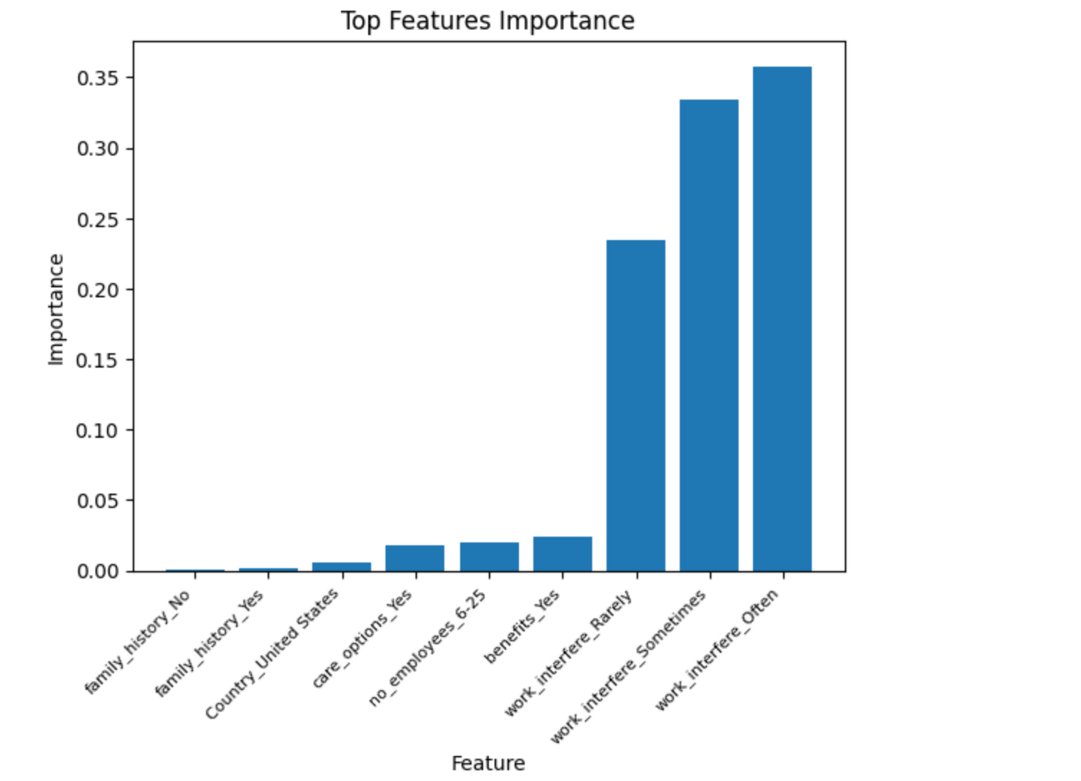
Top Feature importance

Slide 30
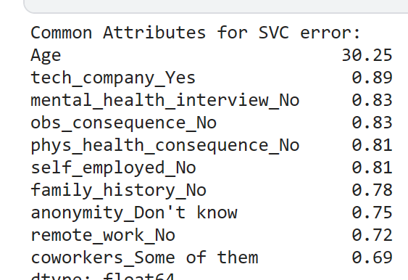
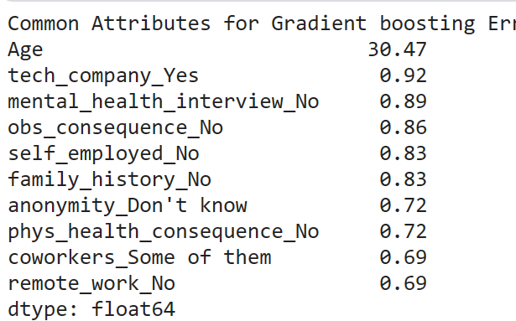
Common Attributes Error for Gradient Boosting and SVC
The two models are
Similar. They are both heavily influenced by the age.

Slide 31
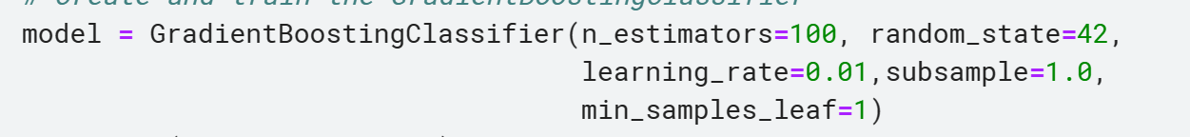
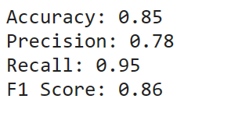
Improvement on boosting trees
We change the learning rate multiple times and deciding to set it to 0.01

Slide 32

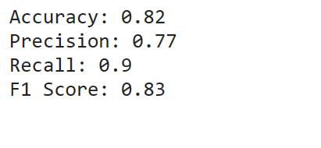
Improvement on SVC
After changing the kernel from rbf to linear we obtained much better results.

Slide 33
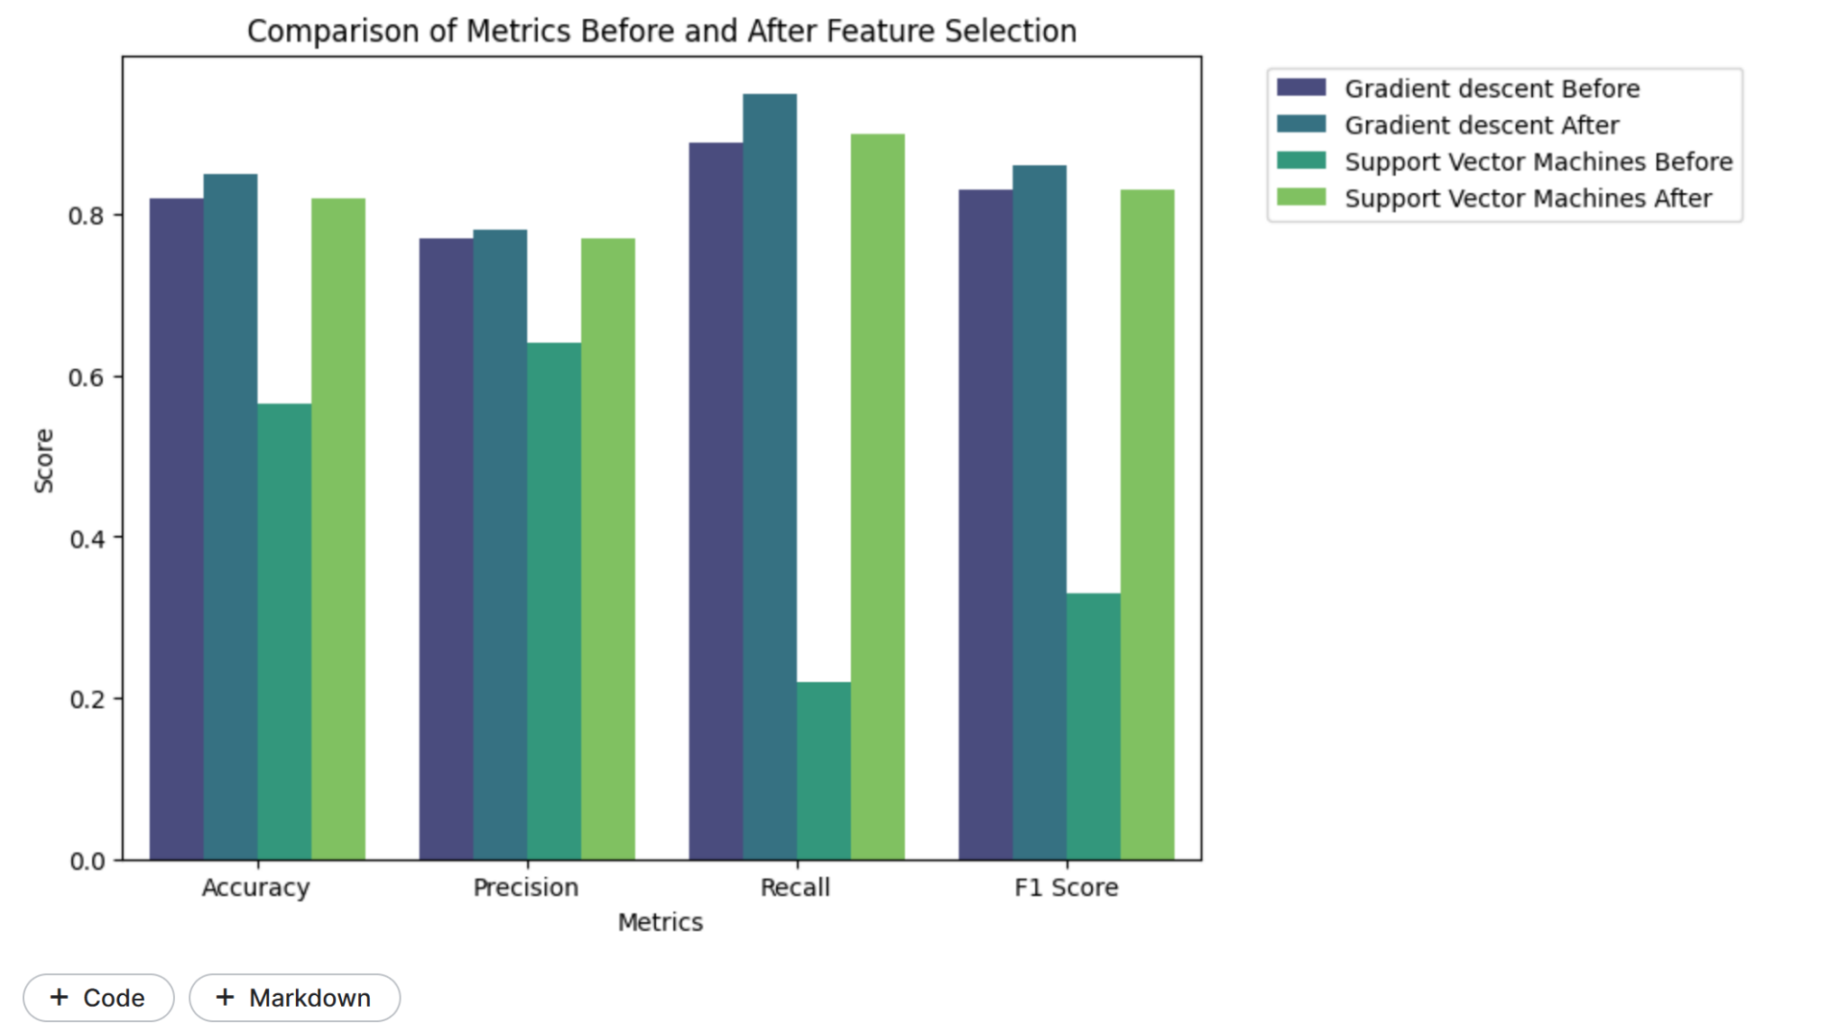
Boosting Tree and Support Vector Machines
We can see that after changing the learning
Rate our model becomes more efficient.
Also the charge in the algorithm use is
Important. SVC’s accuracy went from around
50% to 80%, when changing the algorithm from
Rbf to linear

Slide 34
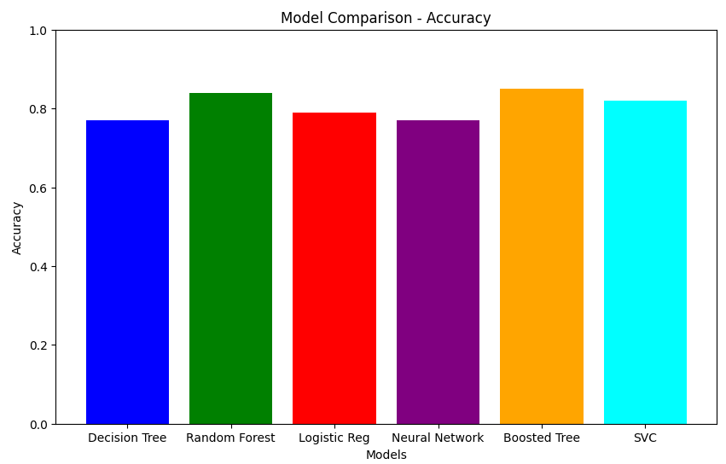
Conclusion

